Slide 1
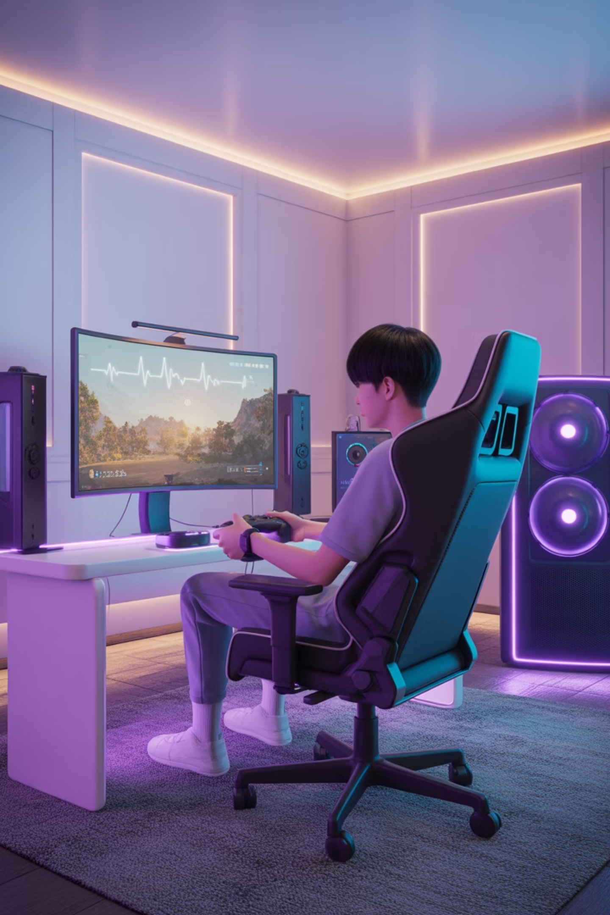
Psyshield
Play Smart. Stay Healthy.
Group Name: Innovation Design Team
Team Members：
Sihan.Wu
Haoran.Sun
Bowen.Yu
Huayan.Sun
Jinxin.Chen
Yangguang.Xv
Jiayu.Chen

Slide 2
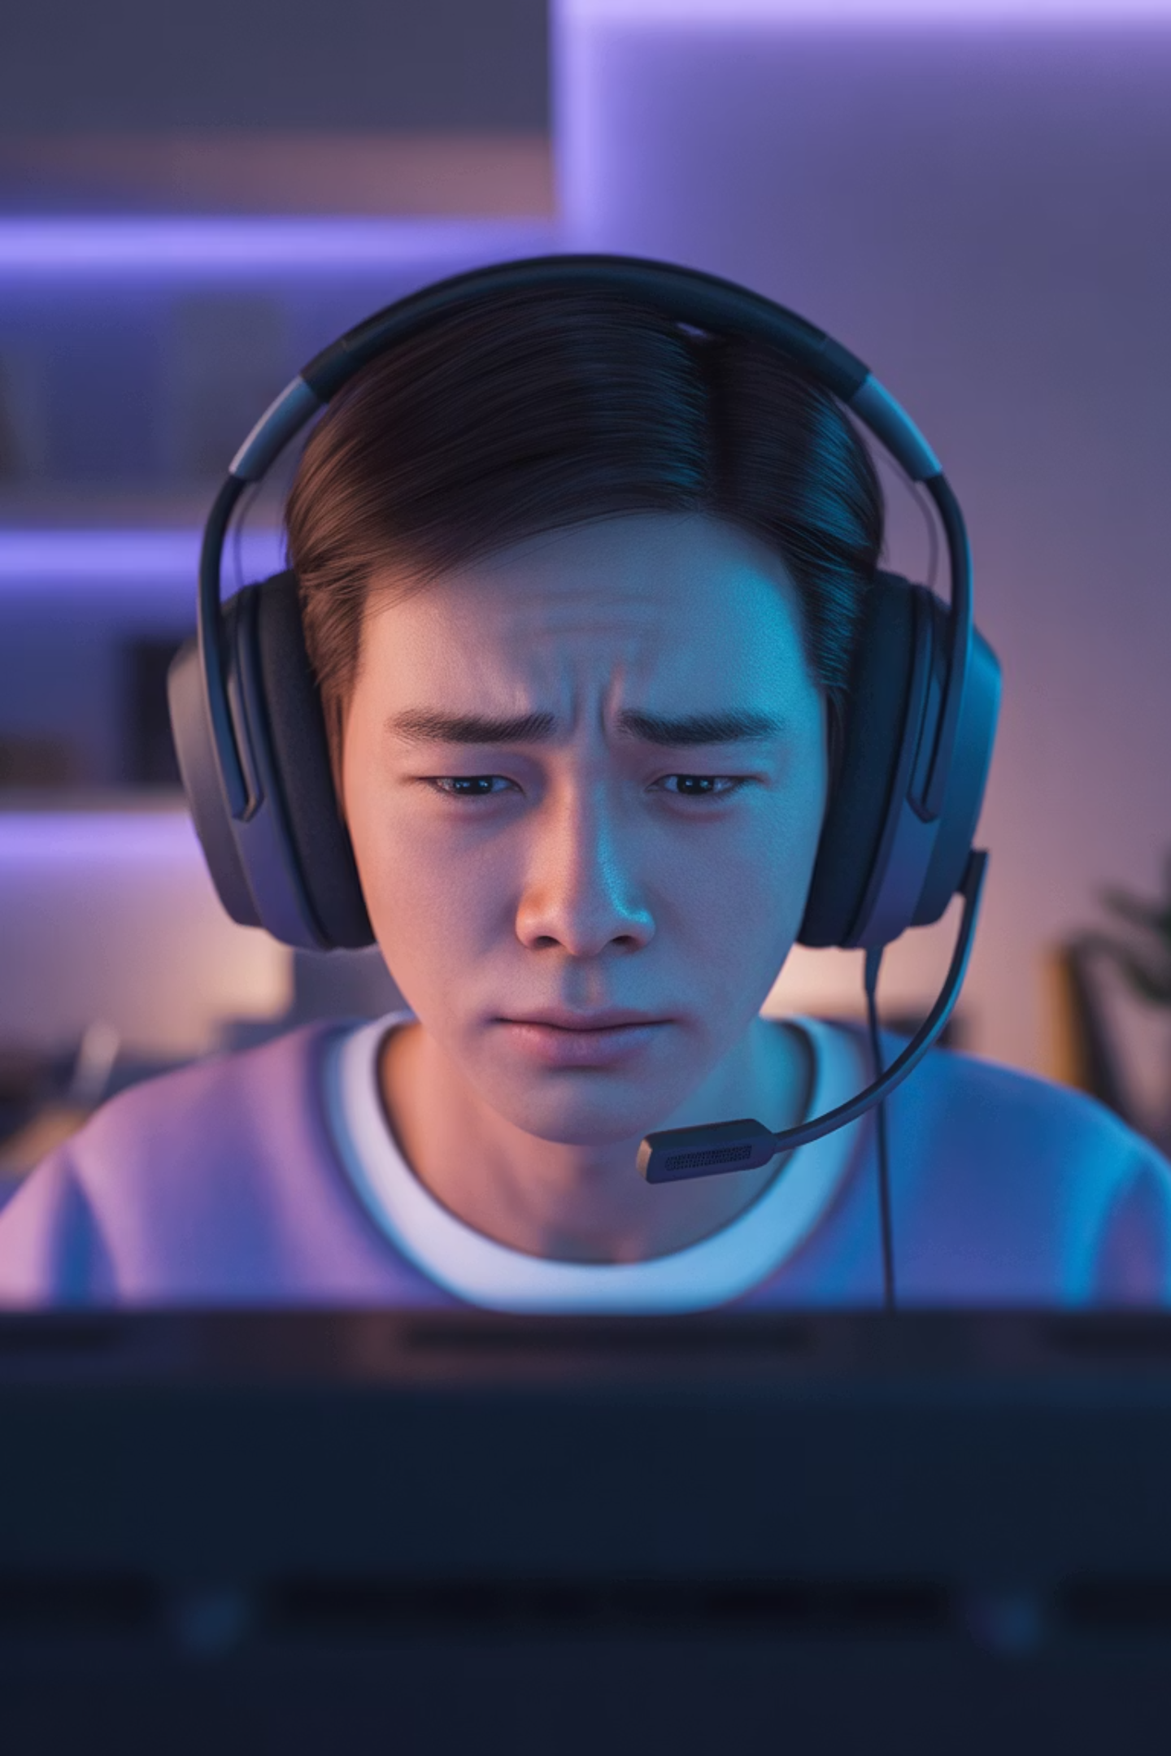
Health Challenges Faced by Gamers
Players often face significant physical and psychological strain
during long gaming sessions.
Key Pain Points
·Prolonged gameplay can lead to elevated heart rate, tension, and fatigue
·Players tend to ignore warning signals sent by their bodies
·There is a lack of convenient, real-time, and non-intrusive health monitoring
tools designed for gaming scenarios
Why Does This Matter?
To safeguard players’ physical and mental well-being, we need a real-time
health monitoring solution that fits naturally into the gaming experience.

Slide 3
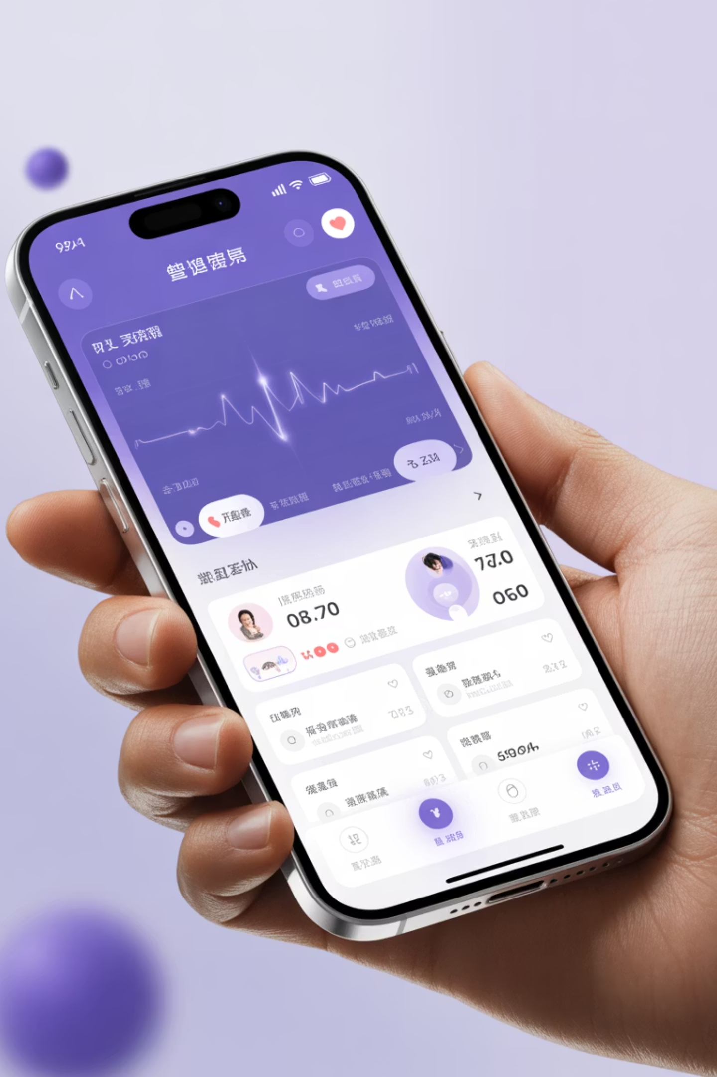


Psyshield：Intelligent Health Guardian
Real-Time Monitoring
Smart Alerts
Continuously tracks players’ health
indicators
Provides proactive warnings during
high stress or abnormal heart rate
Emotional Support
Safety Protection
Offers a safe space for emotional
expression and sharing
Automatically notifies your emergency
contacts in abnormal situations
The core philosophy of Psyshield is to help players “play healthier, not stop playing.” We believe that through intelligent monitoring and human-centered alerts, players can enjoy gaming while maintaining good physical and mental well-being.

Slide 4

🌟 Innovative Highlight Features
Smart Warning System
Seamless Transition Experience
AI Emotional Companion
When health indicators reach predefined thresholds, the system automatically triggers alerts, ensuring players never miss critical signals.
After an alert is triggered, the app automatically guides the player to the mood-sharing space, integrating health management into the gaming experience without interruption.
Players can choose to chat with the intelligent AI, using natural language interactions to relieve stress and receive instant emotional support.
These combined features create a proactive, caring, and non-intrusive health protection system,
achieving the perfect balance between technology and human-centered design.

Slide 5
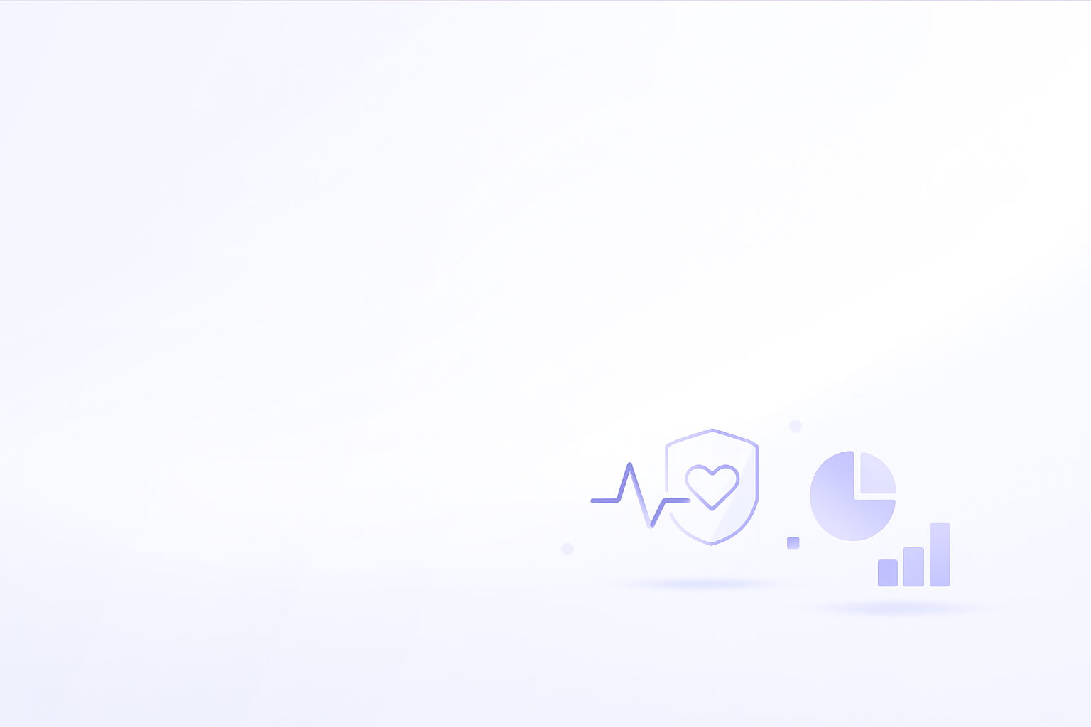




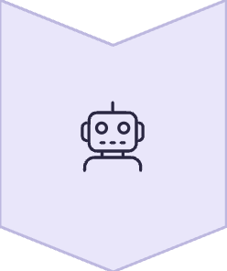

Five Core Functions
01
02
03
Physiological Status Detection
Data Sharing
Abnormal State Alerts
Records heart rate and other physiological indicators
in real time to help track health trends.
Automatically syncs abnormal indicators with trusted contacts.
Provides immediate warnings and guidance when
physiological or emotional indicators become abnormal.
04
05
Social Interaction
AI Emotional Chat
Offers a real-time forum for players to share
health status and gaming experiences.
Provides an intelligent conversation companion to help players relieve stress and express emotions.
Home
Dashboard
Heart
Rate
Entry
Smart
Alert
Emotion
Sharing
AI
Conversation

Slide 6

User Testing Insights
11
4.2
87%
test user
Average game duration
Satisfaction score
Participate in the entire testing process
Daily hours
User recognition
We truly care about what our users need. So, we invited 11 players to test our product. Their feedback has helped us find three key points:
1
2
3
Share your health status
simplicity of operator
AI Emotional companionship
players want to share their health status and support friends.
the feature must be simple to use and not interrupt gameplay.
when feeling stressed, they need someone to talk to for support.

Slide 7
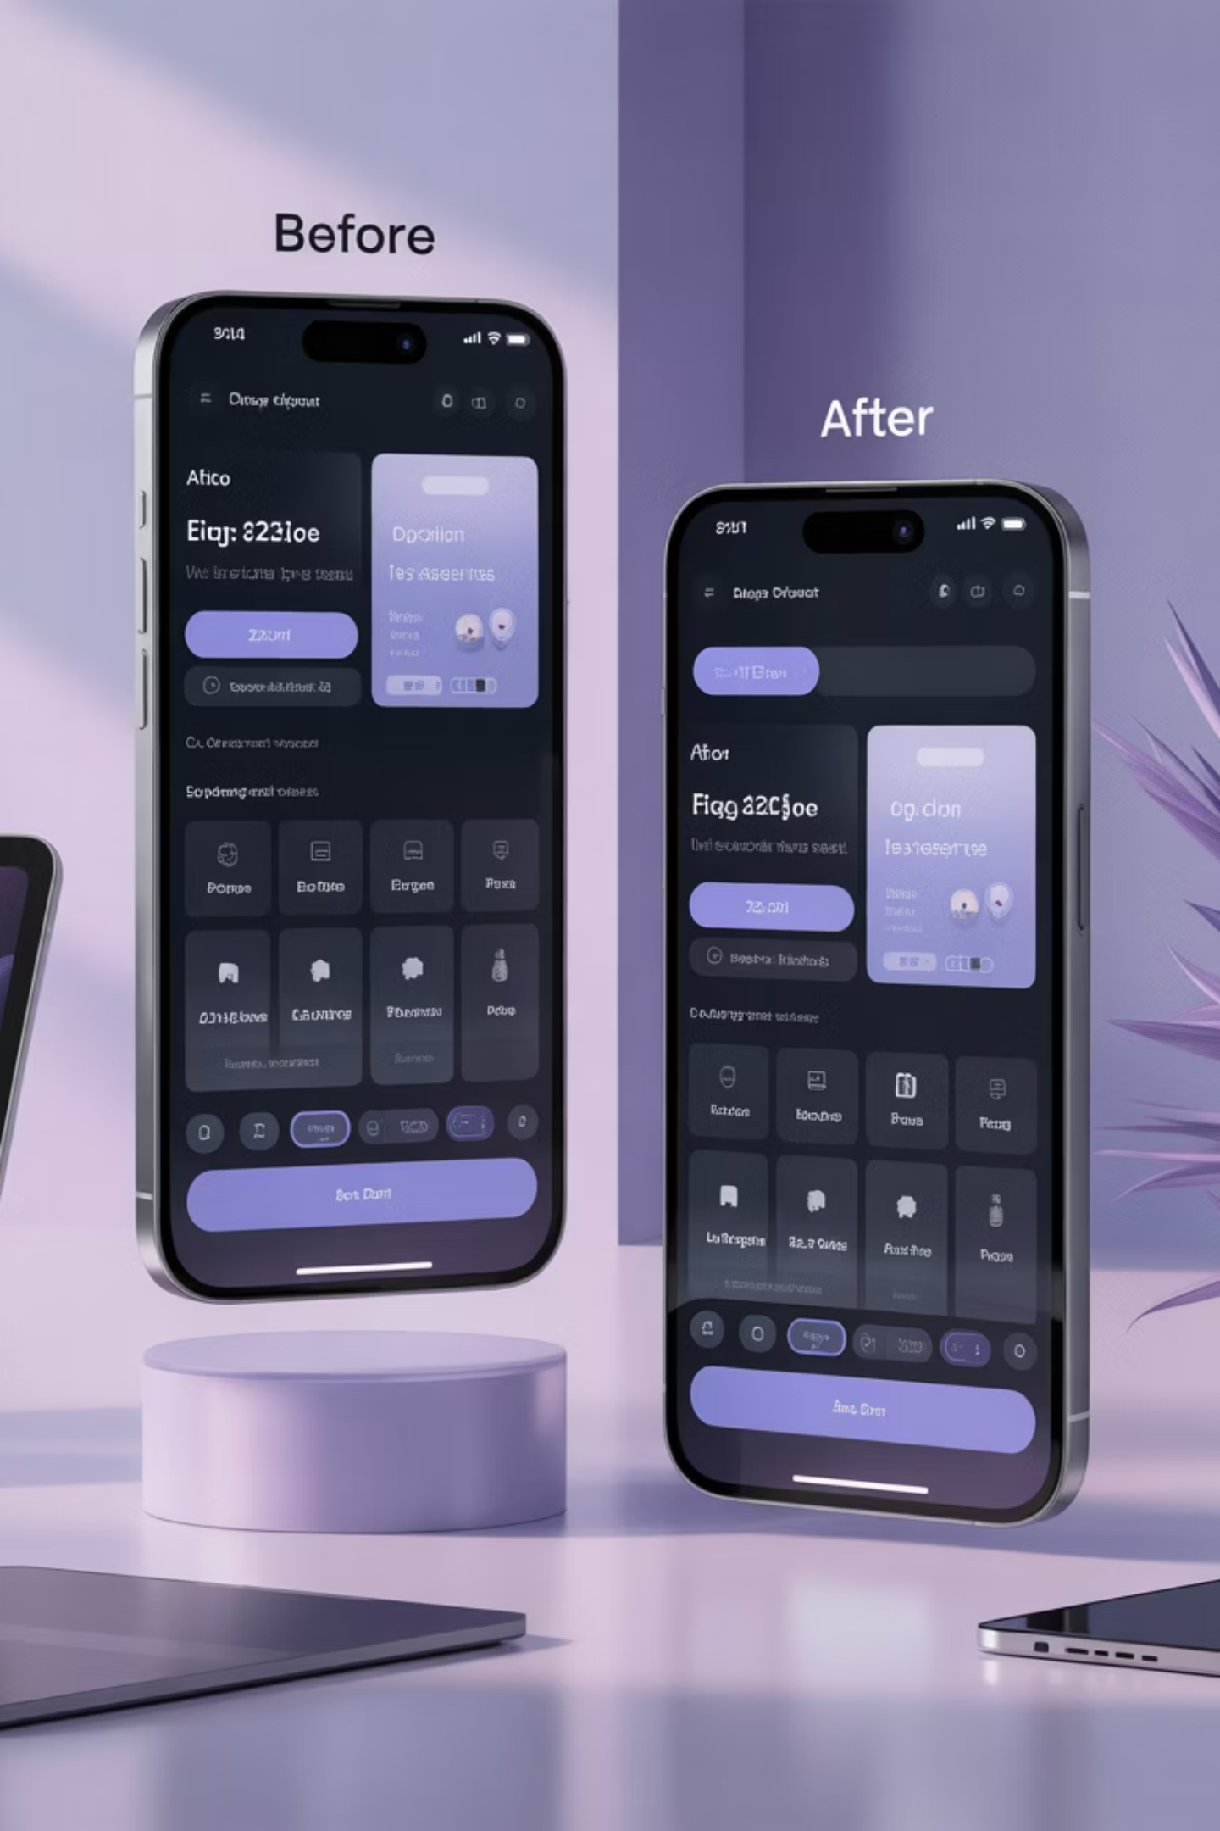
Iterative upgrade based on feedback
original version
we only had basic heart rate input
upgrades
upgrade version
We added a social function for sharing moods and health progress.
We made input faster and easier, so it doesn’t disrupt the game.
We added an AI companion to give warm and timely emotional support.
difficulty
We also solved technical challenges and kept user data safe while building these features.

Slide 8
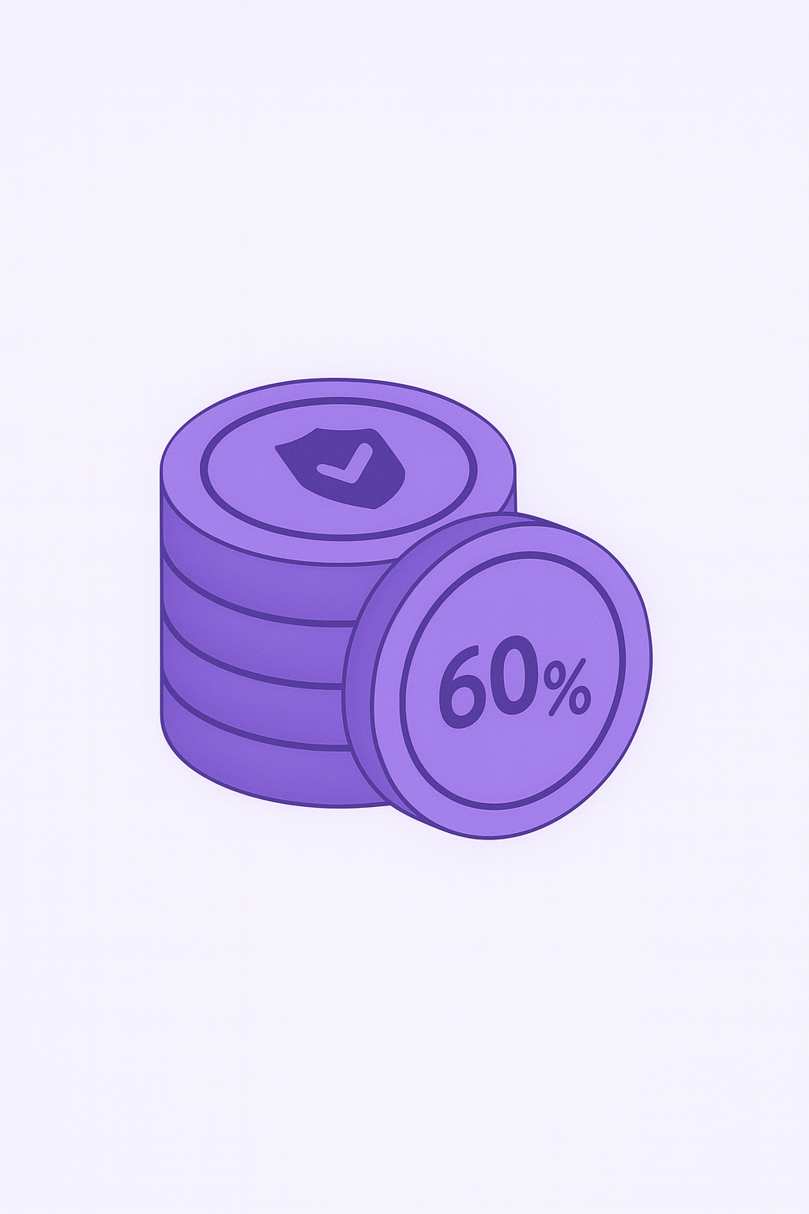
From market validation to commercial implementation
Pre-promote the product plan and create videos/web pages
Observe the market response
126 website visits,
87 video plays,
14 survey responses,
21 user registrations
🆓 Free features:
Heart rate monitoring, basic AI chat healing, forum interaction
💎 paid model:
personalized health plans
smarter AI support
multi-device health reports.
Many players in WeChat groups said
this is exactly the health tool they need

Slide 9
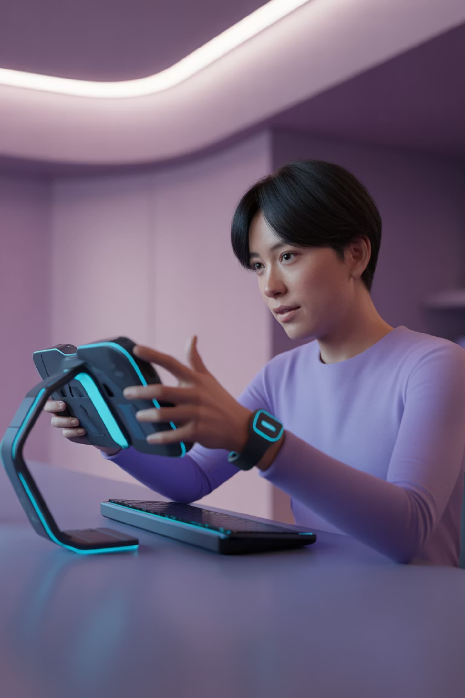

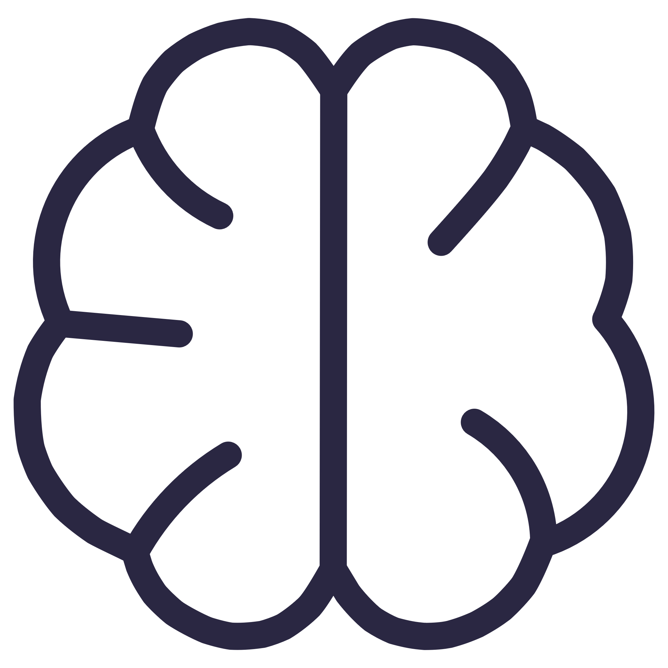
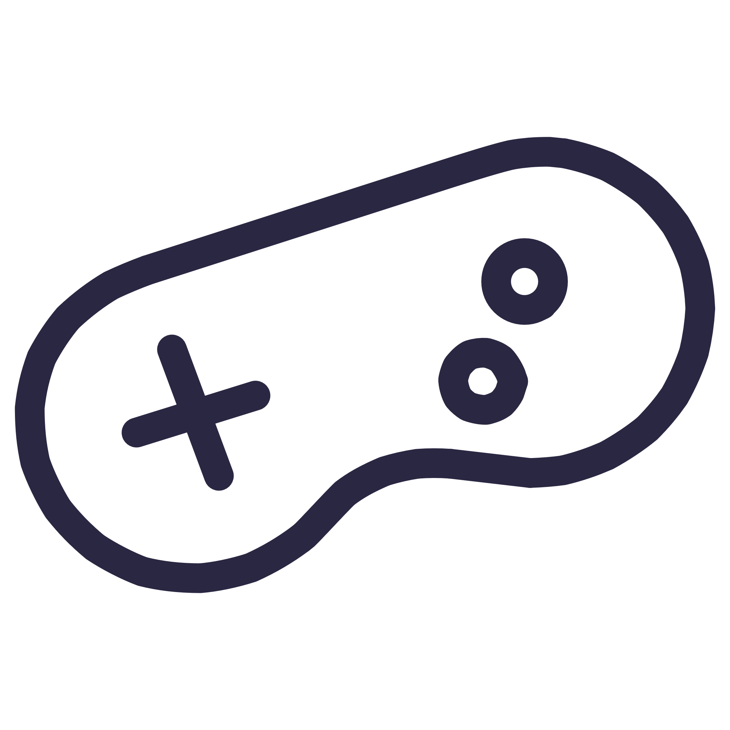
Summary and Future Outlook
goal
to help players stay healthy while enjoying games.
future plan
automatic heart rate tracking
smarter AI support
With smart wear deep integration to realize no perceived health monitoring equipment
Upgrade the AI model to provide more accurate
emotion recognition and personalized support
in-game overlay mode
Develop the floating window function to fully integrate health monitoring into the game interface
。
We want PsyShield to be not just a tool, but a long-term health partner for every player.

